Slide 1
ASP.NET WebAPI (2.2)
Angular 2 radionica

Slide 2
ASP.NET Web API
…je framework za kreiranje web APIja pomoću .NET Framework-a.
…je Application Programming Interface (API) za komunikaciju web-servera i klijenta (web browser-mobilne aplikacije)
Serverski Web API je programski interface koji se sastoji od jednog ili više javno objavljenih endpointova, čime se definira request-response sistem komunikacije, tipično koristeći JSON ili XML za razmjenu podataka, najčešće putem HTTPa i od strane Web servera
Notes:
A server-side web API is a programmatic interface consisting of one or more publicly exposed endpoints to a defined request–response message system, typically expressed in JSON or XML, which is exposed via the web—most commonly by means of an HTTP-based web server.
https://en.wikipedia.org/wiki/Web_API
Server side[edit]
A server-side web API is a programmatic interface consisting of one or more publicly exposed endpoints to a defined request–response message system, typically expressed in JSON or XML, which is exposed via the web—most commonly by means of an HTTP-based web server. Mashups are web applications which combine the use of multiple server-side web APIs.^{[1][2][3]} Webhooks are server-side web APIs that take as input an Uniform Resource Identifier (URI) that is designed to be used like a remote named pipe or a type of callback such that the server acts as a client to dereference the provided URI and trigger an event on another server which handles this event thus providing a type of peer-to-peer IPC. There are some PHP microframeworks such as Lumen to build a REST API. ^{[4]}
Endpoints[edit]
Endpoints are important aspects of interacting with server-side web APIs, as they specify where resources lie that can be accessed by third party software. Usually the access is via a URI to which HTTP requests are posed, and from which the response is thus expected.
Endpoints need to be static, otherwise the correct functioning of software that interacts with it cannot be guaranteed. If the location of a resource changes (and with it the endpoint) then previously written software will break, as the required resource can no longer be found at the same place. As API providers still want to update their web APIs, many have introduced a versioning system in the URI that points to an endpoint, for example the Clarifai API: The endpoint for the tagging functionality within the web API has the following URI: "https://api.clarifai.com/v1/tag/". The "/v1/" part of the URI specifies access to the first version of the web API. If clarifai decides to update to version two, they can do this while still maintaining support for third party software that uses the first version.^{[5]}
Resource vs. service[edit]
Although "web API" is sometimes considered a synonym for web service, many Web 2.0 web applications have moved away from SOAP-based web services towards collections of RESTful web resources.^{[6]}These RESTful web APIs are accessible via standard HTTP methods by a variety of HTTP clients including browsers and mobile devices. They have advantages over web services in that they tend to be less resource intensive (and thus usually run faster) if they use JSON as message exchange format because in that case they do not need to perform XML-to-programming language data conversions as required by a SOAP-based service APIs.^{[7][8]}
Signs of these industry changes can be seen by:^{[8]}
Yahoo provides REST for all their services
Amazon and eBay provide both REST and SOAP
Google used to only provide SOAP, but deprecated these resources, in favour of REST in 2006
This move from web services to web APIs is analogous to the Semantic Web movement towards the Resource Description Framework.^{[9]}
Documentation[edit]
Server-side web APIs are interfaces for the outside world to interact with the business logic. For many companies this internal business logic and the intellectual property associated with it are what distinguishes them from other companies, and potentially what gives them a competitive edge. They do not want this information to be exposed. However, in order to provide a web API of high quality, there needs to be a sufficient level of documentation. One API provider that not only provides documentation, but also links to it in its error messages is Twilio.^{[10]}
However, there are now directories of popular documented server-side web APIs.^{[11]}
Growth and impact[edit]
The number of available web APIs has grown consistently over the past years, as businesses realize the growth opportunities associated with running an open platform, that any developer can interact with. ProgrammableWeb tracks 9000 Web APIs that were available in 2013, up from 105 in 2005.^{[12]}
Web APIs have become ubiquitous. There are few major software applications/services that do not offer some form of web API. One of the most common forms of interacting with these web APIs is via embedding external resources, such as tweets, Facebook comments, YouTube videos, vines, etc. In fact there are very successful companies, such as Disqus, whose main service is to provide embedable tools, such as a feature-rich comment system.^{[13]} Any website of the TOP 100 Alexa Internet ranked websites uses APIs and/or provides its own APIs, which is a very distinct indicator for the prodigious scale and impact of web APIs as a whole.^{[14]}
As the number of available web APIs has grown, open source tools have been developed to provide more sophisticated search and discovery. APIs.json provides a machine-readable description of an API and its operations, and the related project APIs.io offers a searchable public listing of APIs based on the APIs.json metadata format.^{[15][16]}
Business[edit]
Commercial[edit]
There are a lot of companies and organizations, which heavily rely on their API infrastructure to serve their core business clients. In 2014 Netflix received around 5 billion API requests, most of them within their private API.^{[17]}
Governmental[edit]
Many governments collect a lot of data, and some governments are now opening up access to this data. The interfaces through which this data is typically made accessible are web APIs. Web APIs allow for data, such as "budget, public works, crime, legal, and other agency data"^{[18]} to be accessed by any developer in a convenient manner.
The United States are one of the pioneers in opening up government data for anybody and everybody to use. On its website, data.gov, the following is stated: "Since his first full day in office, President Obama has prioritized making government more open and accountable and has taken substantial steps to increase citizen participation, collaboration, and transparency in government. Data.gov, the central site for U.S. Government data, is an important part of the Administration’s overall effort to open government."^{[19]}
Client side[edit]
A client-side web API is a programmatic interface to extend functionality within a web browser or other HTTP client. Originally these were most commonly in the form of native plug-in browser extensions however most newer ones target standardized JavaScript bindings.
The Mozilla Foundation created their WebAPI specification which is designed to help replace native mobile applications with HTML5 applications.^{[20][21]}
Google created their Native Client architecture which is designed to help replace insecure native plug-ins with secure native sandboxed extensions and applications. They have also made this portable by employing a modified LLVM AOT compiler.

Slide 3
ASP.NET Web API– kroz povijest
Asp.NET Web API je framework za kreiranje HTTP servisa, čije usluge mogu koristiti razne vrste klijenata, od browsera-aplikacija u njima, mobitela, tableta, smart televizija i razne druge vrste uređaja
Pojavio se kao dio ASP.NET Mvc 4 verzije, 2011 g.
Visual Studio 2010 SP1 -> Visual Studio 2012
Koristimo stvari poput HttpVerbove (Get,Post…), HttpHeader, Request,Response,URI
Današnja verzija ASP.NET WebAPI 2.2
Notes:
https://docs.microsoft.com/en-us/aspnet/web-api/
https://docs.microsoft.com/en-us/aspnet/web-api/overview/older-versions/build-restful-apis-with-aspnet-web-api
https://docs.microsoft.com/en-us/aspnet/core/tutorials/first-web-api
http://www.dotnettricks.com/learn/webapi/what-is-web-api-and-why-to-use-it-

Slide 4
ASP.NET Web API
Do verzije ASP.NET Mvc 5-WebAPI 2.2
Dva namespacea i dva odvojena skupa biblioteka (NuGet packages) (System.Web.Mvc vs System.Web.Http)
System.Web.MVC.Controller base class vs System.Web.Http.ApiController base class
Od verzije ASP.NET Mvc 6, postoji samo Microsoft.AspNet.Mvc.Controller (i Mvc i WebAPI)
ASP.NET Core vs ASP.NET

Slide 5
ASP.NET Web API – Mogućnosti
Web API osobine
Lagan za naučiti 80% funkcionalnosti
Podrška za HttpVerbove
Kada koristiti
Potrebno ispoljiti „javno” postojeći sistem
Potrebno kreirati novi Web Servis, ali nema potrebe za SOAP-WSDL
HttpStatusCode i Accept header
MediaTypeFormatter
Prima i šalje razne vrste formata
oData podrška
Varijabilno hostanje
Podrška za Mvc feature
IoC-DI podrška
Podrška za CRUD akcije
Potrebno kreirati aplikacijski server (API)
Za nove SPA projekte
Za nove mobile projekte
Notes:
http://www.dotnettricks.com/learn/webapi/what-is-web-api-and-why-to-use-it-

Slide 6
ASP.NET Web API– novosti po verzijama
MS Web API 2
Attribute Routing (RoutePrefix i Route)!
OAuth 2.0 podrška kroz novi security - Microsoft OWIN Token bearer authentication
Bolja podrška za Unit Testing
Uveden IHttpActionResult (Ok, NotFound, InternalServerError)!
CORS podrška
Authentication Filters - Filter Overrides
!OWIN podrška!
MS Web API 2.1
Global Error Handling
BSON (Binary JSON) podrška
MS Web API 2.2
Download kroz NuGet (verzija paketa 5.2.0)
oData v4
Poboljšanja u AttributeRoutingu (extensibility point: IDirectRouteProvider)

Slide 7
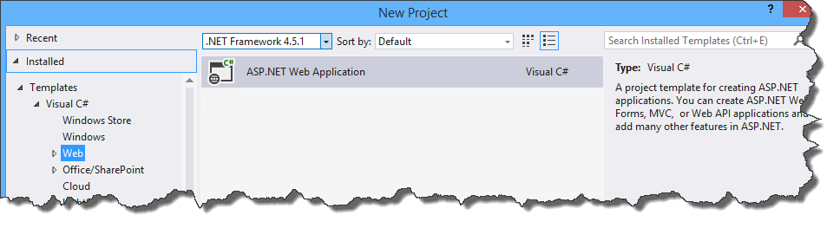
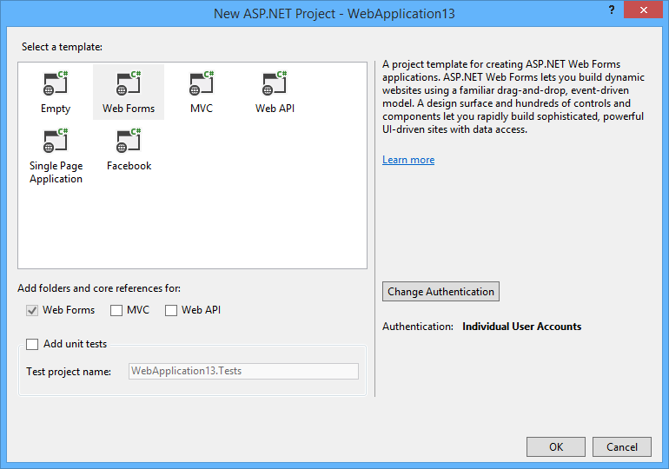
ASP.NET Web API - Visual Studio 2013
Notes:
VS 2013 je i dalje aktualan alat.
Iako kroz Visual Studio izgleda kao da je to „jedna platforma-skup biblioteka”, u stvarnosti to nije tako.

Slide 8
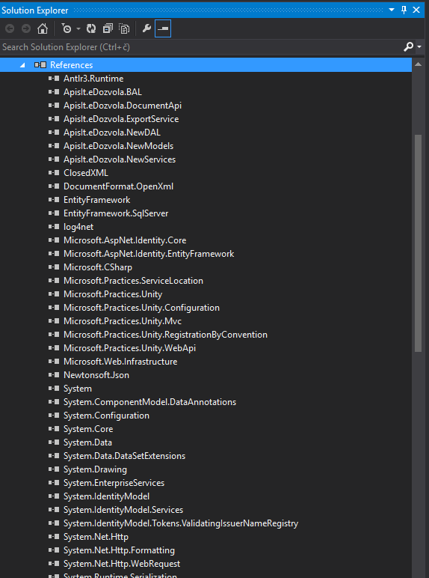
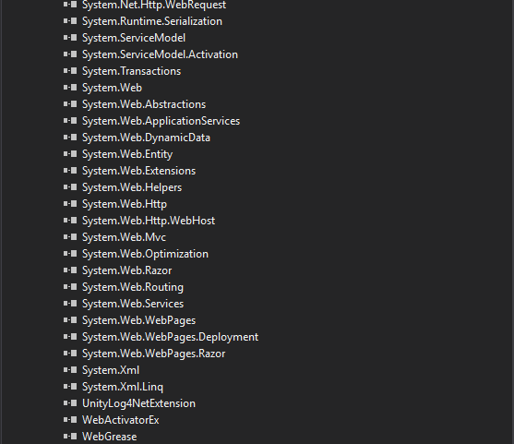
ASP.NET Web API – VS 2013 – projektne reference
Notes:
ASP.NET Mvc 5 + WebAPI 2.2 + IoC + security + log4net + servisne reference + ….

Slide 9
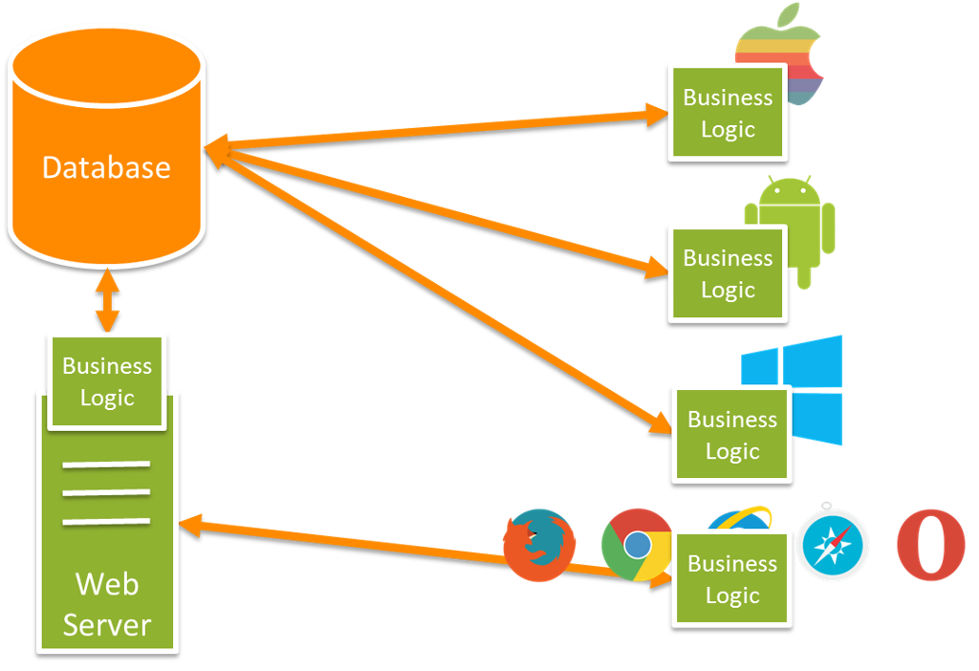
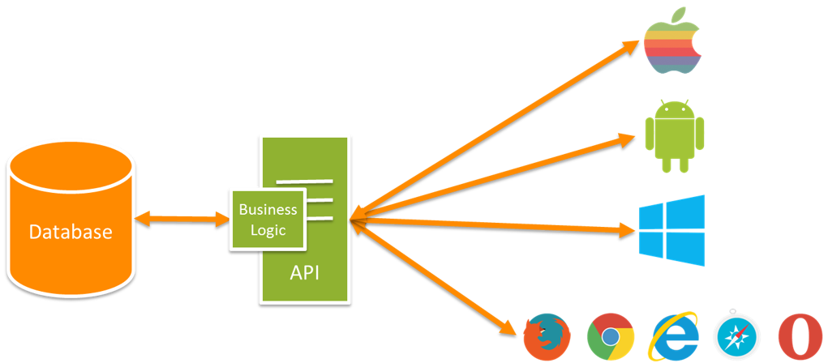
Mvc vs WebAPI

Slide 10
ASP.NET Web API - osnove
Izgradnja Http servisa
Model-ViewModel-Controller
Controller – objekt koji procesira Http Request-ove
Mvc Controller vs ApiController
Mvc Controller nasljeđuje od Controller bazne klase
Api Controller nasljeđuje od ApiController bazne klase
Mvc akcijske metode vraćaju view-ove
Api akcijske metode isključivo vraćaju podatke ili HttpStatusCode
Svaka metoda na Controller klasi koja ima access modifier public, je dostupna za poziv od strane klijenta

Slide 11
Web API Configuration Settings
HttpConfiguration objekt (App_Start → WebApiConfig.Register)
DependencyResolver – IoC
Filters – action filteri
Formatters – Media Formateri
IncludeErrorDetailPolicy – uključiti detaljan opis greške u Http Response-u
Initializer – kod koji obavlja završnu inicijalizaciju
Message Handlers – umetanje u Api pipeline (za cross-cutting concernes ili sl.)
ParameterBindingRules – skup pravila za mapiranje parametara na akcijama
Routes – dictionary svih ruta i „handlera”
Kolekcija servisa
Notes:
https://docs.microsoft.com/en-us/aspnet/web-api/overview/advanced/configuring-aspnet-web-api
https://docs.microsoft.com/en-us/aspnet/web-api/overview/advanced/configuring-aspnet-web-api#services
http://www.ryansouthgate.com/2015/07/17/web-api-2-includeerrordetailpolicy/

Slide 12
Configuration Settings - Services
Extension points aka predviđena mjesta za prilagodbu
Interface | Opis
IHttpControllerSelector | Selects the controller.
IHttpControllerTypeResolver | Gets the list of controller types. The DefaultHttpControllerSelector chooses the controller type from this list.
IAssembliesResolver | Gets the list of project assemblies. The IHttpControllerTypeResolver interface uses this list to find the controller types.
IHttpControllerActivator | Creates new controller instances.
IHttpActionSelector | Selects the action.
IHttpActionInvoker | Invokes the action.
var config = GlobalConfiguration.Configuration;
config.Services.Replace(typeof(IHttpControllerSelector), new MyControllerSelector(config));
config.Services.Add(typeof(IFilterProvider), new MyFilterProvider());
Notes:
To provide your own implementation for any of these interfaces, use the Services collection on the HttpConfiguration object:
To add a custom implementation to a multi-instance service, call Add or Insert on the Services collection:
C# Copy
config.Services.Add(typeof(IFilterProvider), new MyFilterProvider()); To replace a single-instance service with a custom implementation, call Replace on the Services collection:
C# Copy
config.Services.Replace(typeof(ITraceWriter), new MyTraceWriter());
Per-Controller Configuration
You can override the following settings on a per-controller basis:
Media-type formatters
Parameter binding rules
Services
To do so, define a custom attribute that implements the IControllerConfiguration interface. Then apply the attribute to the controller.
The following example replaces the default media-type formatters with a custom formatter.

Slide 13
Routing
Proces mapiranja Http Requesta na API Controller
Api Controller je klasa koja odrađuje Http Requestove
Public metode na Api Controller-u su Action Methods ili Actions
Web API koristi Http metodu (vs Mvc URI putanje) za odabir controller-action
Odabir controllera-actiona se radi pomoću Routing Table
Primjeri: (http://moja-domena.hr)
/api/products ili /api/products/get-all
/api/products/1 ili /api/products/get-product?productId=1
Notes:
https://docs.microsoft.com/en-us/aspnet/web-api/overview/web-api-routing-and-actions/routing-in-aspnet-web-api
When the Web API framework receives an HTTP request, it tries to match the URI against one of the route templates in the routing table. If no route matches, the client receives a 404 error.
The reason for using "api" in the route is to avoid collisions with ASP.NET MVC routing. That way, you can have "/contacts" go to an MVC controller, and "/api/contacts" go to a Web API controller. Of course, if you don't like this convention, you can change the default route table.

Slide 14
Routing II
Routing table
Attribute Routing
App_Start → WebAPIConfig.cs
config.Routes.MapHttpRoute(
name: "DefaultApi",
routeTemplate: "api/{controller}/{id}",
defaults: new { id = RouteParameter.Optional });
config.MapHttpAttributeRoutes();
Notes:
https://docs.microsoft.com/en-us/aspnet/web-api/overview/web-api-routing-and-actions/routing-in-aspnet-web-api
When the Web API framework receives an HTTP request, it tries to match the URI against one of the route templates in the routing table. If no route matches, the client receives a 404 error.
The reason for using "api" in the route is to avoid collisions with ASP.NET MVC routing. That way, you can have "/contacts" go to an MVC controller, and "/api/contacts" go to a Web API controller. Of course, if you don't like this convention, you can change the default route table.
To find the controller, Web API adds "Controller" to the value of the {controller} variable.
To find the action, Web API looks at the HTTP method, and then looks for an action whose name begins with that HTTP method name. For example, with a GET request, Web API looks for an action that starts with "Get...", such as "GetContact" or "GetAllContacts". This convention applies only to GET, POST, PUT, and DELETE methods. You can enable other HTTP methods by using attributes on your controller. We'll see an example of that later.
Other placeholder variables in the route template, such as {id}, are mapped to action parameters.

Slide 15
Routing IIa
Routing ima tri koraka
Pronalaženje route templatea u Route tablici
Odabir controller klase
Odabir action metode
Predviđeno je prilagođavanje cijelog defaultnog procesa vlastitim potrebama pomoću vlastitih implementacija-promjena
Notes:
https://docs.microsoft.com/en-us/aspnet/web-api/overview/web-api-routing-and-actions/routing-and-action-selection
You can also provide constraints, which restrict how a URI segment can match a placeholder:
Copy
JavaScript
constraints: new { id = @"\d+" } // Only matches if "id" is one or more digits. The framework tries to match the segments in the URI path to the template. Literals in the template must match exactly. A placeholder matches any value, unless you specify constraints. The framework does not match other parts of the URI, such as the host name or the query parameters. The framework selects the first route in the route table that matches the URI.1
There are two special placeholders: "{controller}" and "{action}".
"{controller}" provides the name of the controller.
"{action}" provides the name of the action. In Web API, the usual convention is to omit "{action}".
Defaults
If you provide defaults, the route will match a URI that is missing those segments. For example:
Copy
C#
routes.MapHttpRoute( name: "DefaultApi", routeTemplate: "api/{controller}/{category}", defaults: new { category = "all" } ); The URI "http://localhost/api/products" matches this route. The "{category}" segment is assigned the default value "all".
Route Dictionary
If the framework finds a match for a URI, it creates a dictionary that contains the value for each placeholder. The keys are the placeholder names, not including the curly braces. The values are taken from the URI path or from the defaults. The dictionary is stored in the IHttpRouteData object.
During this route-matching phase, the special "{controller}" and "{action}" placeholders are treated just like the other placeholders. They are simply stored in the dictionary with the other values.
A default can have the special value RouteParameter.Optional. If a placeholder gets assigned this value, the value is not added to the route dictionary. For example:
Copy
C#
routes.MapHttpRoute( name: "DefaultApi", routeTemplate: "api/{controller}/{category}/{id}", defaults: new { category = "all", id = RouteParameter.Optional } ); For the URI path "api/products", the route dictionary will contain:
controller: "products"
category: "all"
For "api/products/toys/123", however, the route dictionary will contain:
controller: "products"
category: "toys"
id: "123"
The defaults can also include a value that does not appear anywhere in the route template. If the route matches, that value is stored in the dictionary. For example:
Copy
C#
routes.MapHttpRoute( name: "Root", routeTemplate: "api/root/{id}", defaults: new { controller = "customers", id = RouteParameter.Optional } ); If the URI path is "api/root/8", the dictionary will contain two values:
controller: "customers"
id: "8"
Selecting a Controller
Controller selection is handled by the IHttpControllerSelector.SelectController method. This method takes an HttpRequestMessage instance and returns an HttpControllerDescriptor. The default implementation is provided by the DefaultHttpControllerSelector class. This class uses a straightforward algorithm:
Look in the route dictionary for the key "controller".
Take the value for this key and append the string "Controller" to get the controller type name.
Look for a Web API controller with this type name.
1
For example, if the route dictionary contains the key-value pair "controller" = "products", then the controller type is "ProductsController". If there is no matching type, or multiple matches, the framework returns an error to the client.
For step 3, DefaultHttpControllerSelector uses the IHttpControllerTypeResolver interface to get the list of Web API controller types. The default implementation of IHttpControllerTypeResolver returns all public classes that (a) implement IHttpController, (b) are not abstract, and (c) have a name that ends in "Controller".
Action Selection
After selecting the controller, the framework selects the action by calling the IHttpActionSelector.SelectAction method. This method takes an HttpControllerContext and returns an HttpActionDescriptor.
The default implementation is provided by the ApiControllerActionSelector class. To select an action, it looks at the following:
The HTTP method of the request.
The "{action}" placeholder in the route template, if present.
The parameters of the actions on the controller.
Before looking at the selection algorithm, we need to understand some things about controller actions.
Which methods on the controller are considered "actions"? When selecting an action, the framework only looks at public instance methods on the controller. Also, it excludes "special name" methods (constructors, events, operator overloads, and so forth), and methods inherited from the ApiController class.
HTTP Methods. The framework only chooses actions that match the HTTP method of the request, determined as follows:
You can specify the HTTP method with an attribute: AcceptVerbs, HttpDelete, HttpGet, HttpHead, HttpOptions, HttpPatch, HttpPost, or HttpPut.
Otherwise, if the name of the controller method starts with "Get", "Post", "Put", "Delete", "Head", "Options", or "Patch", then by convention the action supports that HTTP method.
If none of the above, the method supports POST.
Parameter Bindings. A parameter binding is how Web API creates a value for a parameter. Here is the default rule for parameter binding:
Simple types are taken from the URI.
Complex types are taken from the request body.
Simple types include all of the .NET Framework primitive types, plus DateTime, Decimal, Guid, String, and TimeSpan. For each action, at most one parameter can read the request body.
Note
It is possible to override the default binding rules. See WebAPI Parameter binding under the hood.
With that background, here is the action selection algorithm.
Create a list of all actions on the controller that match the HTTP request method.
If the route dictionary has an "action" entry, remove actions whose name does not match this value.
Try to match action parameters to the URI, as follows:
For each action, get a list of the parameters that are a simple type, where the binding gets the parameter from the URI. Exclude optional parameters.
From this list, try to find a match for each parameter name, either in the route dictionary or in the URI query string. Matches are case insensitive and do not depend on the parameter order.
Select an action where every parameter in the list has a match in the URI.
If more that one action meets these criteria, pick the one with the most parameter matches.
Ignore actions with the [NonAction] attribute.
Step #3 is probably the most confusing. The basic idea is that a parameter can get its value either from the URI, from the request body, or from a custom binding. For parameters that come from the URI, we want to ensure that the URI actually contains a value for that parameter, either in the path (via the route dictionary) or in the query string.
For example, consider the following action:
Copy
C#
public void Get(int id) The id parameter binds to the URI. Therefore, this action can only match a URI that contains a value for "id", either in the route dictionary or in the query string.
Optional parameters are an exception, because they are optional. For an optional parameter, it's OK if the binding can't get the value from the URI.
Complex types are an exception for a different reason. A complex type can only bind to the URI through a custom binding. But in that case, the framework cannot know in advance whether the parameter would bind to a particular URI. To find out, it would need to invoke the binding. The goal of the selection algorithm is to select an action from the static description, before invoking any bindings. Therefore, complex types are excluded from the matching algorithm.
After the action is selected, all parameter bindings are invoked.
Summary:
The action must match the HTTP method of the request.
The action name must match the "action" entry in the route dictionary, if present.
For every parameter of the action, if the parameter is taken from the URI, then the parameter name must be found either in the route dictionary or in the URI query string. (Optional parameters and parameters with complex types are excluded.)
Try to match the most number of parameters. The best match might be a method with no parameters.

Slide 16
Routing III
Primjer
Rezultat
public class ProductsController : ApiController
{
public void GetAllProducts() { }
public IEnumerable<Product> GetProductById(int id) { }
public HttpResponseMessage DeleteProduct(int id){ }
}
HTTP Metoda | URI Putanja | Action | Parameter
GET | api/products | GetAllProducts | (none)
GET | api/products/4 | GetProductById | 4
DELETE | api/products/4 | DeleteProduct | 4
POST | api/products | (no match)
Notes:
Once a matching route is found, Web API selects the controller and the action:
To find the controller, Web API adds "Controller" to the value of the {controller} variable.
To find the action, Web API looks at the HTTP method, and then looks for an action whose name begins with that HTTP method name. For example, with a GET request, Web API looks for an action that starts with "Get...", such as "GetContact" or "GetAllContacts". This convention applies only to GET, POST, PUT, and DELETE methods. You can enable other HTTP methods by using attributes on your controller. We'll see an example of that later.
Other placeholder variables in the route template, such as {id}, are mapped to action parameters.

Slide 17
Routing IV
public class ProductsController : ApiController
{
[HttpGet]
public Product GetProduct(id)
{
}
}
public class ProductsController : ApiController
{
[AcceptVerbs("GET", "HEAD")]
public Product FindProduct(id) { }
[HttpPost]
public IHttpActionResult SaveProduct(Product product) { }
}
Notes:
Instead of using the naming convention for HTTP methods, you can explicitly specify the HTTP method for an action by decorating the action method with the HttpGet, HttpPut, HttpPost, or HttpDelete attribute.
In the following example, the FindProduct method is mapped to GET requests:
To allow multiple HTTP methods for an action, or to allow HTTP methods other than GET, PUT, POST, and DELETE, use the AcceptVerbs attribute, which takes a list of HTTP methods.
Copy
C#

Slide 18
Routing V
Override odabira prema nazivu metode
GET /api/products/details/1
public class ProductsController : ApiController
{
[HttpGet]
public string Details(int id);
}
ILI
public class ProductsController : ApiController
{
[HttpGet]
[ActionName("Thumbnail")]
public HttpResponseMessage GetThumbnailImage(int id);
[HttpPost]
[ActionName("Thumbnail")]
public void AddThumbnailImage(int id);
}
public class ProductsController : ApiController
{
[NonAction]
public Product GetProduct(id)
{
}
}

Slide 19
Routing – attribute routing
Convention-based routing vs Attribute routing
RoutePrefix & Route
using System.Web.Http;
namespace WebApplication
{
public static class WebApiConfig
{
public static void Register(HttpConfiguration config)
{
// Web API routes
config.MapHttpAttributeRoutes();
// Other Web API configuration not shown.
}
}
}
[RoutePrefix(„products”)]
public class ProductsController : ApiController
{
[Route(„get-products/{id}”)]
[HttpGet]
public Product GetProduct(id)
{
}
}
Notes:
https://docs.microsoft.com/en-us/aspnet/web-api/overview/web-api-routing-and-actions/attribute-routing-in-web-api-2
Why Attribute Routing?
The first release of Web API used convention-based routing. In that type of routing, you define one or more route templates, which are basically parameterized strings. When the framework receives a request, it matches the URI against the route template. (For more information about convention-based routing, see Routing in ASP.NET Web API.
One advantage of convention-based routing is that templates are defined in a single place, and the routing rules are applied consistently across all controllers. Unfortunately, convention-based routing makes it hard to support certain URI patterns that are common in RESTful APIs. For example, resources often contain child resources: Customers have orders, movies have actors, books have authors, and so forth. It's natural to create URIs that reflect these relations:
/customers/1/orders
This type of URI is difficult to create using convention-based routing. Although it can be done, the results don't scale well if you have many controllers or resource types.
With attribute routing, it's trivial to define a route for this URI. You simply add an attribute to the controller action:
Copy
C#
[Route("customers/{customerId}/orders")] public IEnumerable<Order> GetOrdersByCustomer(int customerId) { ... } Here are some other patterns that attribute routing makes easy.
API versioning
In this example, "/api/v1/products" would be routed to a different controller than "/api/v2/products".
/api/v1/products /api/v2/products
Overloaded URI segments
In this example, "1" is an order number, but "pending" maps to a collection.
/orders/1 /orders/pending
Mulitple parameter types
In this example, "1" is an order number, but "2013/06/16" specifies a date.
/orders/1 /orders/2013/06/16
Enabling Attribute Routing
To enable attribute routing, call MapHttpAttributeRoutes during configuration. This extension method is defined in the System.Web.Http.HttpConfigurationExtensions class.
protected void Application_Start() { // WARNING - Not compatible with attribute routing. WebApiConfig.Register(GlobalConfiguration.Configuration); } If attribute routing is enabled, this code will throw an exception. If you upgrade an existing Web API project to use attribute routing, make sure to update this configuration code to the following:
Copy
C#
protected void Application_Start() { // Pass a delegate to the Configure method. GlobalConfiguration.Configure(WebApiConfig.Register); }

Slide 20
ApiController i akcijske metode
public class TweetsController : Controller { // GET: /Tweets/ [HttpGet] public ActionResult Index() { return View(Twitter.GetTweets()); }
}
public class TweetsController : Controller {
// GET: /Tweets/
[HttpGet]
public ActionResult Index()
{
return Json(Twitter.GetTweets(), JsonRequestBehavior.AllowGet);
}
}
public class TweetsController : ApiController {
// GET: /Tweets/
[HttpGet]
public List<Tweet> Index()
{
return Ok(Twitter.GetTweets());
}
}
Notes:
Usporedba Mvc , Mvc-JSON , WebAPI

Slide 21
#PRIMJER 1-Routing i Api Controlleri
Notes:
Koraci:
Kreirati ProductsController ,
kreirati metodu GetProduct → throw new NotImplementedException → TEST
kreirati Product klasu u Models direktoriju, kreirati dummy Product POCO objekt u metodi → vratiti je nazad pomoću HttpResponseMessage
4) Testirati što se događa na Exception (namjerno)
Potrebno već imati postman, kroz koji ćemo testirati

Slide 22
ASP.NET Web API – povratne vrijednosti
WebAPI metode vraćaju (verzija do ASP.NET Core)
Void - HTTP response sa status code 204 (No Content)
Bilo koji tip ili kolekciju
HttpResponseMessage
IHttpActionResult (Ok, NotFound….)
WebAPI metode vraćaju (ASP.NET Core)
IActionResult
Klijent diktira vrstu serijalizacije sa Accept Header parametrom
Media-type formatter – odgovoran za čitanje-pisanje CLR objekata u Http message body (serijalizacija-deserijaliacija)
Notes:
https://docs.microsoft.com/en-us/aspnet/web-api/overview/getting-started-with-aspnet-web-api/action-results

Slide 23
ASP.NET Web API – void return value
public class TestController : ApiController { // GET: /test/ [HttpGet] public void Test() { }
}
Http Response HTTP/1.1 204 No Content Server: Microsoft-IIS/8.0 Date: Mon, 27 Jan 2017 02:13:26 GMT
Notes:
https://docs.microsoft.com/en-us/aspnet/web-api/overview/formats-and-model-binding/content-negotiation

Slide 24
ASP.NET Web API – HttpResponseMessage return value
public class ValuesController : ApiController {
public HttpResponseMessage Get()
{
HttpResponseMessage response = Request.CreateResponse(HttpStatusCode.OK, "value"); response.Content = new StringContent("hello", Encoding.Unicode);
response.Headers.CacheControl = new CacheControlHeaderValue() { MaxAge = TimeSpan.FromMinutes(20) };
return response;
}
}
Http Response HTTP/1.1 200 OK Cache-Control: max-age=1200 Content-Length: 10 Content-Type: text/plain; charset=utf-16 Server: Microsoft-IIS/8.0 Date: Mon, 27 Jan 2017 08:53:35 GMT hello
Notes:
CONTENT NEGOTIATION IN WEBAPI !!
https://docs.microsoft.com/en-us/aspnet/web-api/overview/formats-and-model-binding/content-negotiation
Response.Cache.SetCacheability(HttpCacheability.NoCache); // HTTP 1.1.
Response.Cache.AppendCacheExtension("no-store, must-revalidate");
Response.AppendHeader("Pragma", "no-cache"); // HTTP 1.0.
Response.AppendHeader("If-Modified-Since", "Mon, 26 Jul 1997 05:00:00 GMT");
Response.AppendHeader("Expires", "0"); // Proxies.

Slide 25
ASP.NET Web API – HttpResponseMessage return value
GET http://localhost:21069/api/products/1 HTTP/1.1 Host: localhost:21069
Accept: application/json, text/javascript, */*; q=0.01
public Product GetProduct(int id) { var products = _productsRepository.All;
var item = products.FirstOrDefault(p => p.ID == id);
if (item == null)
{
throw new HttpResponseException(HttpStatusCode.NotFound);
}
return item;
}
HTTP/1.1 200 OK Content-Type: application/json; charset=utf-8 Content-Length: 57 Connection: Close {"Id":1,"Name":"Gizmo","Category":"Widgets","Price":1.99}
Notes:
CONTENT NEGOTIATION IN WEBAPI !!
https://docs.microsoft.com/en-us/aspnet/web-api/overview/formats-and-model-binding/content-negotiation
Response.Cache.SetCacheability(HttpCacheability.NoCache); // HTTP 1.1.
Response.Cache.AppendCacheExtension("no-store, must-revalidate");
Response.AppendHeader("Pragma", "no-cache"); // HTTP 1.0.
Response.AppendHeader("If-Modified-Since", "Mon, 26 Jul 1997 05:00:00 GMT");
Response.AppendHeader("Expires", "0"); // Proxies.

Slide 26
ASP.NET Web API – HttpResponseMessage return value
GET http://localhost:21069/api/products/1 HTTP/1.1 Host: localhost:21069
Accept: application/json, text/javascript, */*; q=0.01
public Product GetProduct(int id) {
var item = _products.FirstOrDefault(p => p.ID == id);
if (item == null)
{
throw new HttpResponseException(HttpStatusCode.NotFound);
}
return item;
}
HTTP/1.1 200 OK Content-Type: application/json; charset=utf-8 Content-Length: 57 Connection: Close {"Id":1,"Name":"Gizmo","Category":"Widgets","Price":1.99}
Notes:
CONTENT NEGOTIATION IN WEBAPI !!
https://docs.microsoft.com/en-us/aspnet/web-api/overview/formats-and-model-binding/content-negotiation
Response.Cache.SetCacheability(HttpCacheability.NoCache); // HTTP 1.1.
Response.Cache.AppendCacheExtension("no-store, must-revalidate");
Response.AppendHeader("Pragma", "no-cache"); // HTTP 1.0.
Response.AppendHeader("If-Modified-Since", "Mon, 26 Jul 1997 05:00:00 GMT");
Response.AppendHeader("Expires", "0"); // Proxies.

Slide 27
ASP.NET Web API – HttpResponseMessage return value
GET http://localhost:21069/api/products/1 HTTP/1.1 Host: localhost:21069
Accept: application/json, text/javascript, */*; q=0.01
public HttpResponseMessage GetProduct(int id)
{
var item = _products.FirstOrDefault(p => p.ID == id);
if (item == null)
{
throw new HttpResponseException(HttpStatusCode.NotFound);
}
return Request.CreateResponse(HttpStatusCode.OK, product);
}
HTTP/1.1 200 OK Content-Type: application/json; charset=utf-8 Content-Length: 57 Connection: Close {"Id":1,"Name":"Gizmo","Category":"Widgets","Price":1.99}
Notes:
http://codebetter.com/glennblock/2012/05/24/two-ways-to-work-with-http-responses-in-apicontroller-httpresponsemessage-and-httpresponseexception/
Two ways to work with HTTP responses in ApiController, HttpResponseMessage and HttpResponseException
ASP.NET Web API provides two different ways to work with manipulating HTTP response messages from within your API Controller action.
Throw an HttpResonseException – This exception allows you to pass in an HttpResponseMessage / set status and headers. Web API will then immediately return the response.
Return an HttpResponseMessage – You can simply return an HttpResponseMessage from your action.
he main difference between the two is this. The exception is useful to immediately stop processing and exit. For example assume I have the following code
//LOCATION
var response = Request.CreateResponse(HttpStatusCode.Created, customer); response.Headers.Location = new Uri(Request.RequestUri, string.format("customer/{0}", customer.id));
http://stackoverflow.com/questions/5043902/whats-the-proper-way-to-set-the-location-header-for-an-http-201-response-in-a-j

Slide 28
#PRIMJER 2- HttpResponseMessage i Exceptioni
Notes:
Koraci:
Kreirati ProductsController ,
kreirati metodu GetProduct → throw new NotImplementedException → TEST
kreirati Product klasu u Models direktoriju, kreirati dummy Product POCO objekt u metodi → vratiti je nazad pomoću HttpResponseMessage
4) Testirati što se događa na Exception (namjerno)
Potrebno već imati postman, kroz koji ćemo testirati

Slide 29
ContentNegotiator
HTTP specifikacija (RFC 2616)
Content Negotiation je proces odabira najbolje reprezentacije(formata) odgovora između niza potencijalnih reprezentacija
Mehanizam implementiran pomoću HTTP Headera
Accept:koji media tipovi su prikladni u odgovoru ("application/json" , "application/xml," ili custom "application/vnd.example+xml„)
Accept-Charset: koji character sets je prikladan (UTF-8 ili ISO 8859-1)
Accept-Encoding: koji content encoding je prikladan (gzip).
Accept-Language: koji je preferirani jezik prikladan "en-us".

Slide 30
Content Negotiation II
Objekt koji vraća rezultat je media formatter
HttpConfiguration objekt → dohvaćanje IContentNegotiator servisa
Lista HttpConfiguration.Formatters kolekcije (što smo sve sposobni serijalizirati-deserijalizirati)
Zove se IContentNegotiatior.Negotiate i proslijeđuje:
The type of object to serialize
The collection of media formatters
The HTTP request
Negotiate vraća
NULL → ne postoji formatter (odgovor HTTP error 406 (Not Acceptable) )
ILI
Koji formatter koristiti
Media type za odgovor
public HttpResponseMessage GetProduct(int id) {
var product = new Product() { Id = id, Name = "Gizmo", Category = "Widgets", Price = 1.99M };
IContentNegotiator negotiator = this.Configuration.Services.GetContentNegotiator();
ContentNegotiationResult result = negotiator.Negotiate( typeof(Product), this.Request, this.Configuration.Formatters);
if (result == null)
{
var response = new HttpResponseMessage(HttpStatusCode.NotAcceptable);
throw new HttpResponseException(response));
}
return new HttpResponseMessage() {
Content = new ObjectContent<Product>(
product, // What we are serializing
result.Formatter, // The media formatter
result.MediaType.MediaType // The MIME type
) };
}
Notes:
https://docs.microsoft.com/en-us/aspnet/web-api/overview/formats-and-model-binding/media-formatters
Default Content Negotiator
The DefaultContentNegotiator class provides the default implementation of IContentNegotiator. It uses several criteria to select a formatter.
First, the formatter must be able to serialize the type. This is verified by calling MediaTypeFormatter.CanWriteType.
Next, the content negotiator looks at each formatter and evaluates how well it matches the HTTP request. To evaluate the match, the content negotiator looks at two things on the formatter:
The SupportedMediaTypes collection, which contains a list of supported media types. The content negotiator tries to match this list against the request Accept header. Note that the Accept header can include ranges. For example, "text/plain" is a match for text/* or */*.
The MediaTypeMappings collection, which contains a list of MediaTypeMapping objects. The MediaTypeMapping class provides a generic way to match HTTP requests with media types. For example, it could map a custom HTTP header to a particular media type.
If there are multiple matches, the match with the highest quality factor wins. For example:
Copy
console
Accept: application/json, application/xml; q=0.9, */*; q=0.1 In this example, application/json has an implied quality factor of 1.0, so it is preferred over application/xml.+
If no matches are found, the content negotiator tries to match on the media type of the request body, if any. For example, if the request contains JSON data, the content negotiator looks for a JSON formatter.
If there are still no matches, the content negotiator simply picks the first formatter that can serialize the type.
Selecting a Character Encoding
After a formatter is selected, the content negotiator chooses the best character encoding by looking at the SupportedEncodings property on the formatter, and matching it against the Accept-Charset header in the request (if any).

Slide 31
Media Formatters
Pomoću Media Typea Web API odlučuje kako da serijalizira i deserijalizira poruku
Media Type ili MIME Type
prepoznaje format-vrstu skupine podataka
U Http-u se to odnosi na format message body-a
sastoji se od dva podatka: tipa i podtipa
Content-Type header specificira format
text/html
image/png
application/json
Specificira primatelju kako da deserijalizira body poruke
Primjer (http response)
HTTP/1.1 200 OK Content-Length: 95267 Content-Type: image/png

Slide 32
Media Formatters II
Kada klijent šalje Request, može uključiti Accept header
Signalizira serveru koji format podataka može primiti
Primjer
Accept: text/html,application/xhtml+xml,application/xml (klijent prima ili HTML ili XHTML ili XML) ILI Accept: application/json → (UTF 8) ILI Accept: application/javascript (JSONP)
Ugrađena podrška za XML, JSON, BSON, form-urlencoded data
Podrška za ostale formate pomoću custom media formatter
Notes:
application/json: Official MIME type for json
text/x-json: Experimental(unofficial) MIME type for json before application/json got officially registered
Content-Type: application/jsonFor JSON-P:
Content-Type: application/javascript
application/json application/x-javascript text/javascript text/x-javascript text/x-json
JSONP stands for “JSON with Padding” and it is a workaround for loading data from different domains. It loads the script into the head of the DOM and thus you can access the information as if it were loaded on your own domain, thus by-passing the cross domain issue.

Slide 33
Media Formatters III
Custom media type formatter
Naslijediti od MediaTypeFormattera (asihroni read-write) ILI od BufferedMediaTypeFormattera (sihroni read-write)
Jednostavnije naslijeđivanje od BufferedMediaTypeFormattera, ALI Thread se blokira za vrijeme I/O
Notes:
https://docs.microsoft.com/en-us/aspnet/web-api/overview/formats-and-model-binding/media-formatters
The media type determines how Web API serializes and deserializes the HTTP message body. Web API has built-in support for XML, JSON, BSON, and form-urlencoded data, and you can support additional media types by writing a media formatter.+
To create a media formatter, derive from one of these classes:
MediaTypeFormatter. This class uses asynchronous read and write methods.
BufferedMediaTypeFormatter. This class derives from MediaTypeFormatter but uses sychronous read/write methods.
Deriving from BufferedMediaTypeFormatter is simpler, because there is no asynchronous code, but it also means the calling thread can block during I/O.

Slide 34
#PRIMJER 3 – ContenNegotiator i Custom Type Formatter
Notes:
https://docs.microsoft.com/en-us/aspnet/web-api/overview/formats-and-model-binding/media-formatters

Slide 35
ASP.NET Web API – ExceptionHandling
Default ponašanje na unhandled exception → Http response sa status code 500
HttpResponseException → vraća status code koji vi definirate
public Product GetProduct(int id)
{
Product item = repository.Get(id);
if (item == null)
{
throw new HttpResponseException(HttpStatusCode.NotFound);
}
return item;
}
public Product GetProduct(int id)
{
Product item = repository.Get(id);
if (item == null)
{
var resp = new HttpResponseMessage(HttpStatusCode.NotFound)
{
Content = new StringContent(string.Format("No product with ID = {0}", id)),
ReasonPhrase = "Product ID Not Found"
}
throw new HttpResponseException(resp);
}
return item;
}

Slide 36
ASP.NET Web API – Exception Filteri
Exception Filteri - ako želimo definirati custom ponašanje upravljanja greškama
Exception filter se izvršava kada akcijska metoda izbaci bilo koji unhandled exception OSIM HttpResponseException
HttpResponseException exception
Specijalni slučaj, jer je specifično dizajnirana da vrati Http Response-odgovor
Exception Filter
ILI System.Web.Http.Filters.IExceptionFilter
Naslijeđivanje od System.Web.Http.Filters.ExceptionFilterAttribute klase i override OnException metode
namespace ProductStore.Filters
{
using System;
using System.Net;
using System.Net.Http;
using System.Web.Http.Filters;
public class NotImplExceptionFilterAttribute : ExceptionFilterAttribute
{
public override void OnException(HttpActionExecutedContext context)
{
if (context.Exception is NotImplementedException)
{
context.Response = new HttpResponseMessage(HttpStatusCode.NotImplemented); → vraća 501 – NotImplemented
}
}
}
}
Notes:
https://docs.microsoft.com/en-us/aspnet/web-api/overview/error-handling/exception-handling

Slide 37
ASP.NET Web API – Exception Filteri
Registracija Exception Filtera je moguća na
Nivou metode
Nivou controllera
Globalno
App_Start, WebAPIConfig klasa
Register metoda
GlobalConfiguration.Configuration.Filters kolekcija
config.Filters.Add(new IN2Store.NotImplExceptionFilterAttribute());
HttpError – objekt koji služi za vraćanje informacija o grešci u Http response body
public HttpResponseMessage GetProduct(int id)
{
Product item = repository.Get(id);
if (item == null)
{
var message = string.Format("Product with id = {0} not found", id);
return Request.CreateErrorResponse(HttpStatusCode.NotFound, message);
}
else
{
return Request.CreateResponse(HttpStatusCode.OK, item);
}
}
HTTP/1.1 404 Not Found
Content-Type: application/json; charset=utf-8
Date: Thu, 09 Aug 2012 23:27:18 GMT
Content-Length: 51
{
"Message": "Product with id = 12 not found"
}
Notes:
https://docs.microsoft.com/en-us/aspnet/web-api/overview/error-handling/exception-handling

Slide 38
#PRIMJER 4 - Custom Exception Filteri
Notes:
https://docs.microsoft.com/en-us/aspnet/web-api/overview/error-handling/exception-handling
Ako želimo umjesto generalnog internal server error (500) vraćati odgovore po želji na npr. custom exception ili sl. Kreirati vlastiti Exception Filter

Slide 39
IHttpActionResult
Uveden u Web API 2
Preferirani povratni rezultat
Pojednostavljuje Unit Testiranje
Bolja enkapsulacija i separacija odgovornosti (logika za kreiranje Http odgovora je iza fasade-odvojene klase)
Čišće i preglednije akcijske metode
Izvršavanje
Web API zove ExecuteAsync metodu i kreira HttpResponseMessage
Konvertira se HttpResponseMessage u HTTP odgovor
public interface IHttpActionResult
{
Task<HttpResponseMessage> ExecuteAsync(CancellationToken cancellationToken);
}
Notes:
The IHttpActionResult interface was introducted in Web API 2. Essentially, it defines an HttpResponseMessage factory. Here are some advantages of using the IHttpActionResult interface:1
Simplifies unit testing your controllers.
Moves common logic for creating HTTP responses into separate classes.
Makes the intent of the controller action clearer, by hiding the low-level details of constructing the response.
IHttpActionResult contains a single method, ExecuteAsync, which asynchronously creates an HttpResponseMessage instance.
Copy
C#
public interface IHttpActionResult { Task<HttpResponseMessage> ExecuteAsync(CancellationToken cancellationToken); } If a controller action returns an IHttpActionResult, Web API calls the ExecuteAsync method to create an HttpResponseMessage. Then it converts the HttpResponseMessage into an HTTP response message.2
Here is a simple implementaton of IHttpActionResult that creates a plain text response:

Slide 40
IHttpActionResult II
Jednostavnije i jasnije povratne poruke
Odgovori implementirani u ApiController baznoj klasi
Microsoft isporučio par standardnih odgovora
Ok → return new HttpResponseMessage(HttpStatusCode.OK);
NotFound → throw new HttpResponseException(HttpStatusCode.NotFound);
Exception
Unauthorized
BadRequest
Conflict
Redirect
InvalidModelState

Slide 41
IHttpActionResult
[HttpGet]
public IHttpActionResult GetProduct(int productId)
{
try
{
var product = _productService.GetFullProduct(productId);
if (product == null)
{
return NotFound();
}
var model = product.ToDetailModel();
model.ProductRights = _productSecurityManager.GetProductRights(product);
if (model.ProductRights.CanAccess == false)
{
var response = new HttpResponseMessage(HttpStatusCode.Forbidden);
response.ReasonPhrase = "Korisnik nema pravo pristupa";
return ResponseMessage(response);
}
return Ok(model);
}
catch (Exception ex)
{
return InternalServerError(ex);
}
}

Slide 42
IHttpActionResult – custom response
public class TextResult : IHttpActionResult
{
string _value;
HttpRequestMessage _request;
public TextResult(string value, HttpRequestMessage request)
{
_value = value;
_request = request;
}
public Task<HttpResponseMessage> ExecuteAsync(CancellationToken cancellationToken)
{
var response = new HttpResponseMessage()
{
Content = new StringContent(_value),
RequestMessage = _request
};
return Task.FromResult(response);
}
}
public class ValuesController : ApiController
{
public IHttpActionResult Get()
{
return new TextResult("hello", Request);
}
}
ODGOVOR:
HTTP/1.1 200 OK
Content-Length: 5
Content-Type: text/plain; charset=utf-8
Server: Microsoft-IIS/8.0
Date: Mon, 27 Jan 2014 08:53:35 GMT
hello

Slide 43
IHttpActionResult
IHttpActionResult implementacija je definirana u System.Web.Http.Results
public IHttpActionResult Get (int id)
{
Product product = _productRepository.Get (id);
if (product == null)
{
return NotFound(); // vraća NotFoundResult (404)
}
return Ok(product); // vraća OkNegotiatedContentResult (200)
}
HTTP/1.1 200 OK
Content-Type: application/json; charset=utf-8
Server: Microsoft-IIS/8.0
Date: Mon, 27 Jan 2017 08:53:35 GMT
Content-Length: 56
[{"Id":1,"Name":"Yo-yo","Category":"Toys","Price":6.95}]

Slide 44
#PRIMJER 5- IHttpActionResult i custom action result
Notes:
UNDER-POSTING OVER-POSTING
Custom Validate ModelState Action Filter

Slide 45
HttpError i validacija
public HttpResponseMessage PostProduct(Product item)
{
if (!ModelState.IsValid)
{
return Request.CreateErrorResponse(HttpStatusCode.BadRequest, ModelState);
}
// Implementation not shown...
}
HTTP/1.1 400 Bad Request
Content-Type: application/json; charset=utf-8
Content-Length: 320
{
"Message": "The request is invalid.",
"ModelState": {
"item": [
"Required property 'Name' not found in JSON. Path '', line 1, position 14."
],
"item.Name": [
"The Name field is required."
],
"item.Price": [
"The field Price must be between 0 and 999."
]
}
}
Notes:
https://docs.microsoft.com/en-us/aspnet/web-api/overview/error-handling/exception-handling
https://docs.microsoft.com/en-us/aspnet/web-api/overview/error-handling/web-api-global-error-handling

Slide 46
Akcijske metode – Parameter binding
Parameter binding – proces mapiranja parametara, kada Web API poziva metodu na controlleru
Pravila mapiranja
Jednostavni tipovi podataka (.NET CLR int,bool,double, TimeSpan,GUID,string, decimal) → WebAPI pokušava pročitati iz URI-a
ILI bilo koji tip koji ima TypeConverter
Kompleksni tipovi podataka → media-type formatter iz message body-a ([FromUri] → čitanje kompleksnog tipa iz URIa) Primjer: public HttpResponseMessage Get([FromUri] GeoPoint location) { ... } http://localhost/api/values/?Latitude=47.678558&Longitude=-122.130989 stvaranje tipa → GeoPoint
Notes:
https://docs.microsoft.com/en-us/aspnet/web-api/overview/formats-and-model-binding/parameter-binding-in-aspnet-web-api

Slide 47
Akcijske metode – Parameter binding
Prilagođavanje default mapiranja vlastitim potrebama
Jednostavni tipovi podataka
[FromBody] → čitanje i deserijalizacija iz message body-a Primjer: public HttpResponseMessage Post([FromBody] string name) { ... } POST http://localhost:5076/api/values HTTP/1.1
User-Agent: Fiddler
Host: localhost:5076
Content-Type: application/json
Content-Length: 7
"Alice"
Kompleksni tipovi podataka
[FromUri] → čitanje i deserijalizacija kompleksnog tipa iz URIa Primjer: public HttpResponseMessage Get([FromUri] GeoPoint location) { ... } http://localhost/api/values/?Latitude=47.678558&Longitude=-122.130989 stvaranje tipa → GeoPoint
Notes:
https://docs.microsoft.com/en-us/aspnet/web-api/overview/formats-and-model-binding/parameter-binding-in-aspnet-web-api
When a parameter has [FromBody], Web API uses the Content-Type header to select a formatter. In this example, the content type is "application/json" and the request body is a raw JSON string (not a JSON object).+
At most one parameter is allowed to read from the message body. So this will not work:
Copy
C#
// Caution: Will not work! public HttpResponseMessage Post([FromBody] int id, [FromBody] string name) { ... } The reason for this rule is that the request body might be stored in a non-buffered stream that can only be read once.

Slide 48
Type Converters
Način da Web API tretira kompleksni tip kao jednostavni tip (tj. čita iz URI-a)
[TypeConverter(typeof(GeoPointConverter))]
public class GeoPoint
{
public double Latitude { get; set; }
public double Longitude { get; set; }
public static bool TryParse(string s, out GeoPoint result)
{
result = null;
var parts = s.Split(',');
if (parts.Length != 2)
{
return false;
}
double latitude, longitude;
if (double.TryParse(parts[0], out latitude) &&
double.TryParse(parts[1], out longitude))
{
result = new GeoPoint() { Longitude = longitude, Latitude = latitude };
return true;
}
return false;
}
}
class GeoPointConverter : TypeConverter
{
public override bool CanConvertFrom(ITypeDescriptorContext context, Type sourceType)
{
if (sourceType == typeof(string))
{
return true;
}
return base.CanConvertFrom(context, sourceType);
}
public override object ConvertFrom(ITypeDescriptorContext context,
CultureInfo culture, object value)
{
if (value is string)
{
GeoPoint point;
if (GeoPoint.TryParse((string)value, out point))
{
return point;
}
}
return base.ConvertFrom(context, culture, value);
}
}
Notes:
https://docs.microsoft.com/en-us/aspnet/web-api/overview/formats-and-model-binding/parameter-binding-in-aspnet-web-api
REZULTAT: Web API će tretirati GeoPoint kao jednostavni tip i pokušati ga pročitati iz URIa. Nema potrebe dodati [FromURI]
When a parameter has [FromBody], Web API uses the Content-Type header to select a formatter. In this example, the content type is "application/json" and the request body is a raw JSON string (not a JSON object).
At most one parameter is allowed to read from the message body. So this will not work:
C# Copy
// Caution: Will not work! public HttpResponseMessage Post([FromBody] int id, [FromBody] string name) { ... } The reason for this rule is that the request body might be stored in a non-buffered stream that can only be read once.

Slide 49
Type Converters II
Rezultat:
deklaracija: public HttpResponseMessage Get(GeoPoint location) { ... }
Client poziva sa:
http://localhost/api/values/?location=47.678558,-122.130989
Notes:
BTW:
IActionValueBinder
The entire parameter-binding process is controlled by a pluggable service, IActionValueBinder. The default implementation of IActionValueBinder does the following:
Look for a ParameterBindingAttribute on the parameter. This includes [FromBody], [FromUri], and [ModelBinder], or custom attributes.
Otherwise, look in HttpConfiguration.ParameterBindingRules for a function that returns a non-null HttpParameterBinding.
Otherwise, use the default rules that I described previously.
If the parameter type is "simple"or has a type converter, bind from the URI. This is equivalent to putting the [FromUri] attribute on the parameter.
Otherwise, try to read the parameter from the message body. This is equivalent to putting [FromBody] on the parameter.
If you wanted, you could replace the entire IActionValueBinder service with a custom implementation.

Slide 50
#PRIMJER 6 – Parameter binding i konvertiranje tipa
Notes:
https://docs.microsoft.com/en-us/aspnet/web-api/overview/formats-and-model-binding/parameter-binding-in-aspnet-web-api
FromBody – FromUri
TypeConverter

Slide 51
Model Binding-Binders
Bolji i fleksibilniji način je korištenjem model bindera
Učenje Web API novom model bindingu
Definiramo novi model binder (implementacija IModelBinder.BindModel)
Registriramo ga model binding posistemu
Registracija – Pravila
Na metodi [ModelBinder(typeof(MyModelBinder))]
Povrh klase → [ModelBinder(typeof(LocationModelBinder))]
public class Location { ... }
Globalno
Model binderi dobijaju vrijednosti od value providera
Custom value provider – implementirati IValueProvider interface
Notes:
https://docs.microsoft.com/en-us/aspnet/web-api/overview/formats-and-model-binding/parameter-binding-in-aspnet-web-api (part II)
https://blogs.msdn.microsoft.com/jmstall/2012/04/20/how-to-bind-to-custom-objects-in-action-signatures-in-mvcwebapi/
HttpParameterBinding
Model binders are a specific instance of a more general mechanism. If you look at the [ModelBinder] attribute, you will see that it derives from the abstract ParameterBindingAttribute class. This class defines a single method, GetBinding, which returns an HttpParameterBinding object:
An HttpParameterBinding is responsible for binding a parameter to a value. In the case of [ModelBinder], the attribute returns an HttpParameterBinding implementation that uses an IModelBinder to perform the actual binding. You can also implement your own HttpParameterBinding.
IActionValueBinder
The entire parameter-binding process is controlled by a pluggable service, IActionValueBinder. The default implementation of IActionValueBinder does the following:
Look for a ParameterBindingAttribute on the parameter. This includes [FromBody], [FromUri], and [ModelBinder], or custom attributes.
Otherwise, look in HttpConfiguration.ParameterBindingRules for a function that returns a non-null HttpParameterBinding.
Otherwise, use the default rules that I described previously.
If the parameter type is "simple"or has a type converter, bind from the URI. This is equivalent to putting the [FromUri] attribute on the parameter.
Otherwise, try to read the parameter from the message body. This is equivalent to putting [FromBody] on the parameter.
If you wanted, you could replace the entire IActionValueBinder service with a custom implementation.
http://aspnet.codeplex.com/sourcecontrol/latest#Samples/WebApi/CustomParameterBinding/ReadMe.txt
Finally, you can add a model-binder provider to the HttpConfiguration. A model-binder provider is simply a factory class that creates a model binder. You can create a provider by deriving from the ModelBinderProvider class. However, if your model binder handles a single type, it's easier to use the built-in SimpleModelBinderProvider, which is designed for this purpose. The following code shows how to do this.
Copy
C#
public static class WebApiConfig { public static void Register(HttpConfiguration config) { var provider = new SimpleModelBinderProvider( typeof(GeoPoint), new GeoPointModelBinder()); config.Services.Insert(typeof(ModelBinderProvider), 0, provider); // ... } } With a model-binding provider, you still need to add the [ModelBinder] attribute to the parameter, to tell Web API that it should use a model binder and not a media-type formatter. But now you don't need to specify the type of model binder in the attribute:
Copy
C#
public HttpResponseMessage Get([ModelBinder] GeoPoint location) { ... }
Value Providers
HttpParameterBinding

Slide 52
#PRIMJER 7 - Model binders
Notes:
https://docs.microsoft.com/en-us/aspnet/web-api/overview/formats-and-model-binding/parameter-binding-in-aspnet-web-api
Brzi primjer:
Poco klasa Product, ostaviti samo name i price,
Kreirati type converter
Registrirati ga povrh poco klase
Rezultat: public HttpResponseMessage Get(Product product) { ... }
http://localhost/api/products/get?name=some, 100

Slide 53
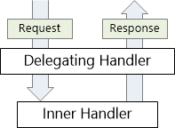
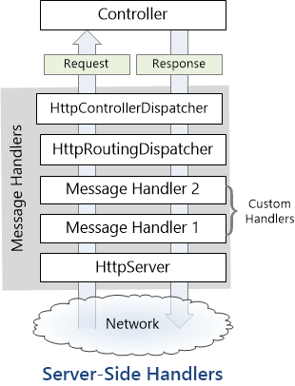
HTTP Message Handlers
Klasa koja sudjeluje u obradi Http Request-a i vraća Http Response
Nasljeđuje se od abstraktne HttpMessageHandler klase
Na serveru, WebAPI koristi slijedeće message handlere
HttpServer – dobija poruku od host-a
HttpRoutingDispatch – proslijeđuje poruku u ovisnosti o ruti
HttpControllerDispatcher – šalje request na API Controller
Predviđeno dodavanje custom handlera u pipelineu
Notes:
https://docs.microsoft.com/en-us/aspnet/web-api/overview/advanced/http-message-handlers

Slide 54
Security - intro
Authentication & Authorization of users
Kroz povijest
2005 - ASP.NET membership system aka FormsSecurity
cookie based
Forms Authentication
MS SQL Server storage
ASP.NET Simple Membership
WebMatrix i Visual Studio 2010 SP1
Membership Provider (SimpleMembershipProvider) – lakša custom implementacija
Mogućnost spremanja podataka u druge storage (npr. Oracle DB)
ASP.NET Identity
Jedan security provider za sve postojeće MS web frameworke (Mvc, Forms, Web API, SignalR)
Podrška za bilo koji tip aplikacije (web, mobile)
EF Code First za persistance-storage
Podrška za druge storage mehanizme (Azure Storage Table Service, SharePoint,NoSQL, Azure AD)
Česti pojmovi
Basic authentication
Organizational accounts
Token Based security
oAuth (2)
External Accounts
Notes:
https://docs.microsoft.com/en-us/aspnet/identity/overview/getting-started/introduction-to-aspnet-identity
Povijest
The database schema was designed for SQL Server and you can't change it. You can add profile information, but the additional data is packed into a different table, which makes it difficult to access by any means except through the Profile Provider API.
The provider system enables you to change the backing data store, but the system is designed around assumptions appropriate for a relational database. You can write a provider to store membership information in a non-relational storage mechanism, such as Azure Storage Tables, but then you have to work around the relational design by writing a lot of code and a lot of System.NotImplementedException exceptions for methods that don't apply to NoSQL databases.
Since the log-in/log-out functionality is based on Forms Authentication, the membership system can't use OWIN. OWIN includes middleware components for authentication, including support for log-ins using external identity providers (like Microsoft Accounts, Facebook, Google, Twitter), and log-ins using organizational accounts from on-premises Active Directory or Azure Active Directory. OWIN also includes support for OAuth 2.0, JWT and CORS.

Slide 55
Security - Autentikacija
Authentication – pravo pristupa sustavu
Http moduli za autentikaciju
IIS ugrađeni moduli
ASP.NET security moduli
Custom security moduli
Ukupni rezultat:
kreiranje IPrincipal (security context) – Thread.CurrentPrincipal
Identity – objekt koji sadrži informacije o useru
Identity.IsAuthenticated == true → uspješno ulogiran
Http Message Handler Moguće izvesti i autentikaciju pomoću Message Handlera
Notes:
https://docs.microsoft.com/en-us/aspnet/web-api/overview/security/authentication-and-authorization-in-aspnet-web-api

Slide 56
Autentikacija II
Bilo kakva custom authentication logika zahtjeva
Postavljanje Thread.CurrentPrincipal – security context („.NET way”)
Postavljanje HttpContext.Current.User – specifično za ASP.NET
private void SetPrincipal(IPrincipal principal)
{
Thread.CurrentPrincipal = principal;
if (HttpContext.Current != null)
{
HttpContext.Current.User = principal;
}
}
Notes:
https://www.hanselman.com/blog/SystemThreadingThreadCurrentPrincipalVsSystemWebHttpContextCurrentUserOrWhyFormsAuthenticationCanBeSubtle.aspx
https://leastprivilege.com/2012/06/25/important-setting-the-client-principal-in-asp-net-web-api/
Important: Setting the Client Principal in ASP.NET Web API
Posted on June 25, 2012by Dominick Baier
Due to some unfortunate mechanisms buried deep in ASP.NET, setting Thread.CurrentPrincipal in Web API web hosting is not enough.
When hosting in ASP.NET, Thread.CurrentPrincipal might get overridden with HttpContext.Current.User when creating new threads. This means you have to set the principal on both the thread and the HTTP context. See here.
<rant>Oh well, can’t tell you how much I think that sucks. It is not the Web API guys fault – just a good example of why the design around HttpContext.User was completely flawed to start with.</rant>

Slide 57
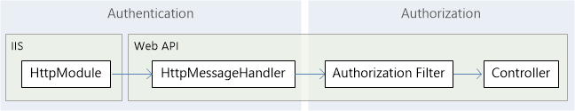
Autorizacija
Autorizacija (što smije korisnik) se događa kasnije u Pipelineu, prije izvođenja controllera i message handlera, ili na nivou controllera
Authorization filters – služe da štite controllere i akcijske metode od „neovlaštenog prisupa”
Unutar akcijskih metoda trenutni principal se može dobiti pomoću ApiController.User (može se i kvalitetnije riješiti)
Notes:
https://www.hanselman.com/blog/SystemThreadingThreadCurrentPrincipalVsSystemWebHttpContextCurrentUserOrWhyFormsAuthenticationCanBeSubtle.aspx
https://leastprivilege.com/2012/06/25/important-setting-the-client-principal-in-asp-net-web-api/
Important: Setting the Client Principal in ASP.NET Web API
Posted on June 25, 2012by Dominick Baier
Due to some unfortunate mechanisms buried deep in ASP.NET, setting Thread.CurrentPrincipal in Web API web hosting is not enough.
When hosting in ASP.NET, Thread.CurrentPrincipal might get overridden with HttpContext.Current.User when creating new threads. This means you have to set the principal on both the thread and the HTTP context. See here.
<rant>Oh well, can’t tell you how much I think that sucks. It is not the Web API guys fault – just a good example of why the design around HttpContext.User was completely flawed to start with.</rant>

Slide 58
Autorizacija II
AuthorizeAttribute (System.Web.Http)
out-of-box dostupan
Štiti resurs nad kojim je registriran i vraća 401 (Unathorized)
Može se primijeniti
Globalno ( HttpConfiguration.Filters.Add(new AuthorizeAttribute() )
Nad controllerom – [Authorize()]
Nad akcijskom metodom – [Authorize()]
Puna sintaksa
[Authorize(Roles=„<NAZIVI”, Users=„<NAZIVI>”)]
[AllowAnnonymous] – dopušta anonimni pristup

Slide 59
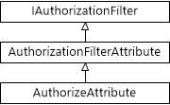
Autorizacija III
Custom filter-atribut
Naslijediti od *AuthorizeAttribute* – custom logika bazirana na trenutnom useru i rolama
Naslijediti od AuthorizationFilterAttribute – custom logika koja ne mora biti bazirana na trenutnom useru
IAuthorizationFilter – implementirati interface za asihronu autorizacijsku logiku (npr. komunikacija sa third-party serverom)
Notes:
https://docs.microsoft.com/en-us/aspnet/web-api/overview/security/authentication-and-authorization-in-aspnet-web-api

Slide 60
Autorizacija III
Individual accounts
Local Accounts (lokalni podaci) ili External Accounts (Facebook, Google, Microsoft)
Koristi se vlastita-membership baza
Organizational accounts (VS 2017 Work or School accounts)
Za korisnike koji se spajaju na
Azure Active Directory
Office 365
on-premise Active Directory
Windows authentication
za intranet korisnike
Koristi se Windows Authentication IIS modul

Slide 61
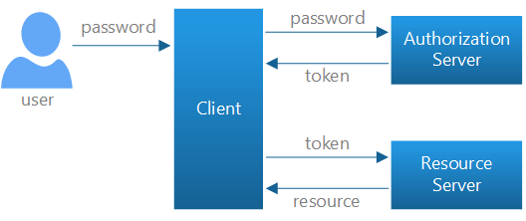
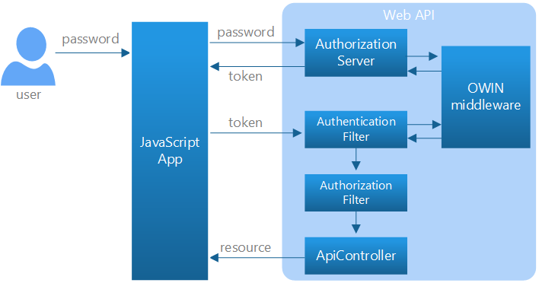
Individual accounts (token based security)
oAuth - resource owner password flow
Web API template – autorizacijski server (validacija i izdavanje tokena)
Notes:
https://docs.microsoft.com/en-us/aspnet/web-api/overview/security/individual-accounts-in-web-api
http://bitoftech.net/2014/06/01/token-based-authentication-asp-net-web-api-2-owin-asp-net-identity/
For local login, Web API uses the resource owner password flow defined in OAuth2.
The user enters a name and password into the client.
The client sends these credentials to the authorization server.
The authorization server authenticates the credentials and returns an access token.
To access a protected resource, the client includes the access token in the Authorization header of the HTTP request.
Default WebAPI Template ukjučuje:
An OAuth2 authorization server.
A Web API endpoint for managing user accounts
An EF model for storing user accounts.
AccountControlle r. Provides a Web API endpoint for managing user accounts. The Register action is the only one that we used in this tutorial. Other methods on the class support password reset, social logins, and other functionality.
ApplicationUser, defined in /Models/IdentityModels.cs. This class is the EF model for user accounts in the membership database.
ApplicationUserManager, defined in /App_Start/IdentityConfig.cs This class derives from UserManager and performs operations on user accounts, such as creating a new user, verifying passwords, and so forth, and automatically persists changes to the database.
ApplicationOAuthProvider. This object plugs into the OWIN middleware, and processes events raised by the middleware. It derives from OAuthAuthorizationServerProvider.
CRFC : https://docs.microsoft.com/en-us/aspnet/web-api/overview/security/preventing-cross-site-request-forgery-csrf-attacks

Slide 62
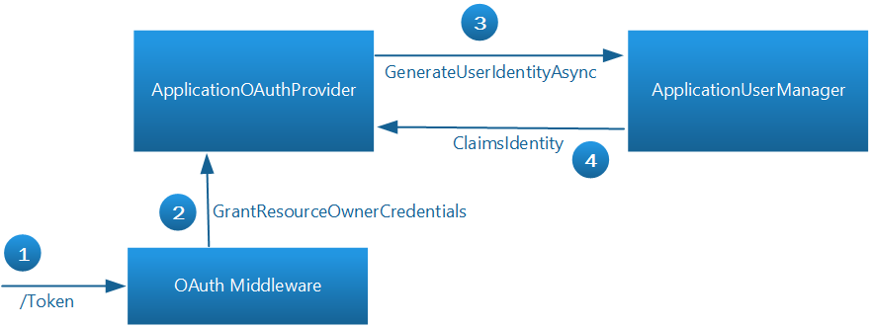
Individual accounts (token based security)
oAuth - resource owner password flow
Web API template – autorizacijski server (validacija i izdavanje tokena)
Notes:
https://docs.microsoft.com/en-us/aspnet/web-api/overview/security/individual-accounts-in-web-api
https://docs.microsoft.com/en-us/aspnet/aspnet/overview/owin-and-katana/owin-oauth-20-authorization-server
http://bitoftech.net/2014/06/01/token-based-authentication-asp-net-web-api-2-owin-asp-net-identity/
In StartupAuth.cs, the following code configures the OAuth2 authorization server.
he TokenEndpointPath property is the URL path to the authorization server endpoint. That's the URL that app uses to get the bearer tokens.
The Provider property specifies a provider that plugs into the OWIN middleware, and processes events raised by the middleware.
Here is the basic flow when the app wants to get a token:
To get an access token, the app sends a request to ~/Token.
The OAuth middleware calls GrantResourceOwnerCredentials on the provider.
The provider calls the ApplicationUserManager to validate the credentials and create a claims identity.
If that succeeds, the provider creates an authentication ticket, which is used to generate the token.
Here is the basic flow when the app wants to get a token:
To get an access token, the app sends a request to ~/Token.
The OAuth middleware calls GrantResourceOwnerCredentials on the provider.
The provider calls the ApplicationUserManager to validate the credentials and create a claims identity.
If that succeeds, the provider creates an authentication ticket, which is used to generate the token.
Configuring Web API to use Bearer Tokens
In the WebApiConfig.Register method, the following code sets up authentication for the Web API pipeline:
Copy
C#
config.SuppressDefaultHostAuthentication(); config.Filters.Add(new HostAuthenticationFilter(OAuthDefaults.AuthenticationType)); The HostAuthenticationFilter class enables authentication using bearer tokens.
The SuppressDefaultHostAuthentication method tells Web API to ignore any authentication that happens before the request reaches the Web API pipeline, either by IIS or by OWIN middleware. That way, we can restrict Web API to authenticate only using bearer tokens.
Note
In particular, the MVC portion of your app might use forms authentication, which stores credentials in a cookie. Cookie-based authentication requires the use of anti-forgery tokens, to prevent CSRF attacks. That's a problem for web APIs, because there is no convenient way for the web API to send the anti-forgery token to the client. (For more background on this issue, see Preventing CSRF Attacks in Web API.) Calling SuppressDefaultHostAuthentication ensures that Web API is not vulnerable to CSRF attacks from credentials stored in cookies.

Slide 63
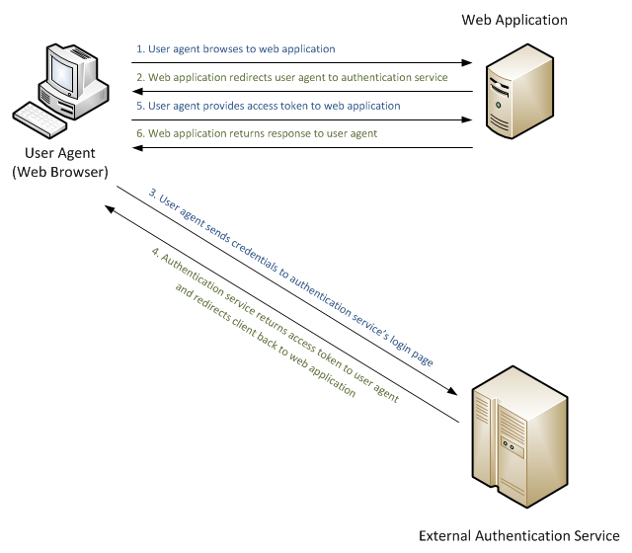
External Accounts
Notes:
https://docs.microsoft.com/en-us/aspnet/web-api/overview/security/external-authentication-services

Slide 64
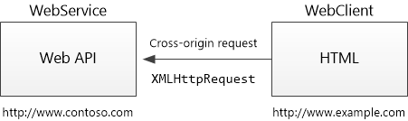
CORS
Browser security spriječava web aplikaciju da napravi request prema drugoj domeni osim izvorišne
Same-origin policy
Cross Origin Resource Sharing – W3C standard koji omogućava serveru da zaobiđe „same-origin polity”
Koristeći CORS server će dozvoliti pozive iz neke domene, dok će odbiti pozive svih ostalih
AJAX request
Notes:
What is "Same Origin"?
Two URLs have the same origin if they have identical schemes, hosts, and ports. (RFC 6454)
These two URLs have the same origin:
http://example.com/foo.html
http://example.com/bar.html
These URLs have different origins than the previous two:
http://example.net - Different domain
http://example.com:9000/foo.html - Different port
https://example.com/foo.html - Different scheme
http://www.example.com/foo.html - Different subdomain
IE ne provjerava PORT ?!

Slide 65
CORS II
Install-Package Microsoft.AspNet.WebApi.Cors
WebApiConfig.cs - HttpConfiguration.EnableCors()
EnableCors
Na nivou akcije
Na nivou controllera
Na globalnom nivou (WebApiConfig.Register → EnableCorsAttribute(„*”,…
Cijeli mehanizam se zasniva na par Http Headera
AJAX request
Notes:
https://docs.microsoft.com/en-us/aspnet/web-api/overview/security/enabling-cross-origin-requests-in-web-api
Set the Allowed HTTP Methods
The methods parameter of the [EnableCors] attribute specifies which HTTP methods are allowed to access the resource. To allow all methods, use the wildcard value "*". The following example allows only GET and POST requests.
Copy
C#
[EnableCors(origins: "http://www.example.com", headers: "*", methods: "get,post")] public class TestController : ApiController { public HttpResponseMessage Get() { ... } public HttpResponseMessage Post() { ... } public HttpResponseMessage Put() { ... } }
Set the Allowed Request Headers
Earlier I described how a preflight request might include an Access-Control-Request-Headers header, listing the HTTP headers set by the application (the so-called "author request headers"). The headers parameter of the [EnableCors] attribute specifies which author request headers are allowed. To allow any headers, set headers to "*". To whitelist specific headers, set headers to a comma-separated list of the allowed headers:
Copy
C#
[EnableCors(origins: "http://example.com", headers: "accept,content-type,origin,x-my-header", methods: "*")] However, browsers are not entirely consistent in how they set Access-Control-Request-Headers. For example, Chrome currently includes "origin"; while FireFox does not include standard headers such as "Accept", even when the application sets them in script.
If you set headers to anything other than "*", you should include at least "accept", "content-type", and "origin", plus any custom headers that you want to support.
Set the Allowed Response Headers
By default, the browser does not expose all of the response headers to the application. The response headers that are available by default are:
Cache-Control
Content-Language
Content-Type
Expires
Last-Modified
Pragma
The CORS spec calls these simple response headers. To make other headers available to the application, set the exposedHeaders parameter of [EnableCors].
In the following example, the controller's Get method sets a custom header named ‘X-Custom-Header'. By default, the browser will not expose this header in a cross-origin request. To make the header available, include ‘X-Custom-Header' in exposedHeaders.
Copy
C#
[EnableCors(origins: "*", headers: "*", methods: "*", exposedHeaders: "X-Custom-Header")] public class TestController : ApiController { public HttpResponseMessage Get() { var resp = new HttpResponseMessage() { Content = new StringContent("GET: Test message") }; resp.Headers.Add("X-Custom-Header", "hello"); return resp; } }
Passing Credentials in Cross-Origin Requests
Credentials require special handling in a CORS request. By default, the browser does not send any credentials with a cross-origin request. Credentials include cookies as well as HTTP authentication schemes. To send credentials with a cross-origin request, the client must set XMLHttpRequest.withCredentials to true.
Using XMLHttpRequest directly:
Copy
C#
var xhr = new XMLHttpRequest(); xhr.open('get', 'http://www.example.com/api/test'); xhr.withCredentials = true; In jQuery:
Copy
JavaScript
$.ajax({ type: 'get', url: 'http://www.example.com/api/test', xhrFields: { withCredentials: true } In addition, the server must allow the credentials. To allow cross-origin credentials in Web API, set the SupportsCredentials property to true on the [EnableCors] attribute:
Copy
C#
[EnableCors(origins: "http://myclient.azurewebsites.net", headers: "*", methods: "*", SupportsCredentials = true)] If this property is true, the HTTP response will include an Access-Control-Allow-Credentials header. This header tells the browser that the server allows credentials for a cross-origin request.
If the browser sends credentials, but the response does not include a valid Access-Control-Allow-Credentials header, the browser will not expose the response to the application, and the AJAX request fails.
Be very careful about setting SupportsCredentials to true, because it means a website at another domain can send a logged-in user's credentials to your Web API on the user's behalf, without the user being aware. The CORS spec also states that setting origins to "*" is invalid if SupportsCredentials is true.
Custom CORS Policy Providers
The [EnableCors] attribute implements the ICorsPolicyProvider interface. You can provide your own implementation by creating a class that derives from Attribute and implements ICorsProlicyProvider.1
Copy
C#
[AttributeUsage(AttributeTargets.Method | AttributeTargets.Class, AllowMultiple = false)] public class MyCorsPolicyAttribute : Attribute, ICorsPolicyProvider { private CorsPolicy _policy; public MyCorsPolicyAttribute() { // Create a CORS policy. _policy = new CorsPolicy { AllowAnyMethod = true, AllowAnyHeader = true }; // Add allowed origins. _policy.Origins.Add("http://myclient.azurewebsites.net"); _policy.Origins.Add("http://www.contoso.com"); } public Task<CorsPolicy> GetCorsPolicyAsync(HttpRequestMessage request) { return Task.FromResult(_policy); } } Now you can apply the attribute any place that you would put [EnableCors].
Copy
C#
[MyCorsPolicy] public class TestController : ApiController { .. // For example, a custom CORS policy provider could read the settings from a configuration file.
As an alternative to using attributes, you can register an ICorsPolicyProviderFactory object that creates ICorsPolicyProvider objects.
Copy
C#
public class CorsPolicyFactory : ICorsPolicyProviderFactory { ICorsPolicyProvider _provider = new MyCorsPolicyProvider(); public ICorsPolicyProvider GetCorsPolicyProvider(HttpRequestMessage request) { return _provider; } } To set the ICorsPolicyProviderFactory, call the SetCorsPolicyProviderFactory extension method at startup, as follows:
Copy
C#
public static class WebApiConfig { public static void Register(HttpConfiguration config) { config.SetCorsPolicyProviderFactory(new CorsPolicyFactory()); config.EnableCors(); // ... } }
Browser Support
The Web API CORS package is a server-side technology. The user's browser also needs to support CORS. Fortunately, the current versions of all major browsers include support for CORS.
Internet Explorer 8 and Internet Explorer 9 have partial support for CORS, using the legacy XDomainRequest object instead of XMLHttpRequest. For more information, see XDomainRequest - Restrictions, Limitations and Workarounds.
9 Comments

Slide 66
CORS III
GET http://myservice.azurewebsites.net/api/test HTTP/1.1
Referer: http://myclient.azurewebsites.net/
Accept: */*
Accept-Language: en-US
Origin: http://myclient.azurewebsites.net
Accept-Encoding: gzip, deflate
User-Agent: Mozilla/5.0 (compatible; MSIE 10.0; Windows NT 6.2; WOW64; Trident/6.0)
Host: myservice.azurewebsites.net
HTTP/1.1 200 OK
Cache-Control: no-cache
Pragma: no-cache
Content-Type: text/plain; charset=utf-8
Access-Control-Allow-Origin: http://myclient.azurewebsites.net
Date: Wed, 05 Jun 2013 06:27:30 GMT
Content-Length: 17
GET: Test message
Notes:
https://docs.microsoft.com/en-us/aspnet/web-api/overview/security/enabling-cross-origin-requests-in-web-api
If the response does not include the Access-Control-Allow-Origin header, the AJAX request fails. Specifically, the browser disallows the request. Even if the server returns a successful response, the browser does not make the response available to the client application.
Preflight Requests
For some CORS requests, the browser sends an additional request, called a "preflight request", before it sends the actual request for the resource.
The browser can skip the preflight request if the following conditions are true:
The request method is GET, HEAD, or POST, and
The application does not set any request headers other than Accept, Accept-Language, Content-Language, Content-Type, or Last-Event-ID, and
The Content-Type header (if set) is one of the following:
application/x-www-form-urlencoded
multipart/form-data
text/plain
The rule about request headers applies to headers that the application sets by calling setRequestHeader on the XMLHttpRequest object. (The CORS specification calls these "author request headers".) The rule does not apply to headers the browser can set, such as User-Agent, Host, or Content-Length.

Slide 67
#PRIMJER 8 - Enable CORS
Notes:
https://docs.microsoft.com/en-us/aspnet/web-api/overview/formats-and-model-binding/parameter-binding-in-aspnet-web-api
Brzi primjer:
Poco klasa Product, ostaviti samo name i price,
Kreirati type converter
Registrirati ga povrh poco klase
Rezultat: public HttpResponseMessage Get(Product product) { ... }
http://localhost/api/products/get?name=some, 100

Slide 68
Dependency Injection
Constructor injection & Setter injection
IDependencyResolver - Web API ima vlastiti dependency resolver
public interface IDependencyResolver : IDependencyScope, IDisposable
{ IDependencyScope BeginScope(); }
public interface IDependencyScope : IDisposable
{ object GetService(Type serviceType); IEnumerable<object> GetServices(Type serviceType); }
public static void Register(HttpConfiguration config)
{
var container = new UnityContainer();
container.RegisterType<IProductRepository, ProductRepository>(new HierarchicalLifetimeManager());
config.DependencyResolver = new UnityResolver(container);
// Other Web API configuration not shown.
}
Notes:
The Web API Dependency Resolver
Web API defines the IDependencyResolver interface for resolving dependencies. Here is the definition of the interface:
Copy
C#
public interface IDependencyResolver : IDependencyScope, IDisposable { IDependencyScope BeginScope(); } public interface IDependencyScope : IDisposable { object GetService(Type serviceType); IEnumerable<object> GetServices(Type serviceType); } The IDependencyScope interface has two methods:
GetService creates one instance of a type.
GetServices creates a collection of objects of a specified type.
The IDependencyResolver method inherits IDependencyScope and adds the BeginScope method. I'll talk about scopes later in this tutorial.
When Web API creates a controller instance, it first calls IDependencyResolver.GetService, passing in the controller type. You can use this extensibility hook to create the controller, resolving any dependencies. If GetService returns null, Web API looks for a parameterless constructor on the controller class.
Dependency Resolution with the Unity Container
Although you could write a complete IDependencyResolver implementation from scratch, the interface is really designed to act as bridge between Web API and existing IoC containers.
An IoC container is a software component that is responsible for managing dependencies. You register types with the container, and then use the container to create objects. The container automatically figures out the dependency relations. Many IoC containers also allow you to control things like object lifetime and scope.
or this tutorial, we'll use Unity from Microsoft Patterns & Practices. (Other popular libraries include Castle Windsor, Spring.Net, Autofac, Ninject, and StructureMap.)
Here is an implementation of IDependencyResolver that wraps a Unity container.

Slide 69
Dependency Scope and Controller Lifetime
Controller instance se kreiraju u scope-u jednog requesta
Scope
određuje životni vijek objekta ili skupine objekata
Za upravljanje životom objekata o kojima controller ovisi, IDependencyResolver koristi scope ➔ jedan web api request
Dependency resolver (npr. Unity) je zakačen za HttpConfiguration objekt, koji ima globalni scope
Kod kreacije WebAPI Controllera, zove se BeginScope, koji se vraća IDependencyScope (child scope)
Na child scope-u se zove GetService(za razjrješenje ovisnosti)
Na kraju requesta, zove se Dispose na child scope-u

Slide 70
Unity IoC Container
Dodati NuGet package Unity.WebAPI (za Web API 5.2.3)
U global.asax dodati liniju UnityConfig.RegisterComponents() (odmah na početku, ispod registracije area)
Dodati PerRequestLifeTimeManager (ako se želi scope objekta ograničiti)
Moguće je koristiti i HierarchicalLifeTimeManager (scope na nivou jednog controllera)

Slide 71
#PRIMJER 9 - dodavanje Unitya
Notes:
The Web API Dependency Resolver
Web API defines the IDependencyResolver interface for resolving dependencies. Here is the definition of the interface:
Copy
C#
public interface IDependencyResolver : IDependencyScope, IDisposable { IDependencyScope BeginScope(); } public interface IDependencyScope : IDisposable { object GetService(Type serviceType); IEnumerable<object> GetServices(Type serviceType); } The IDependencyScope interface has two methods:
GetService creates one instance of a type.
GetServices creates a collection of objects of a specified type.
The IDependencyResolver method inherits IDependencyScope and adds the BeginScope method. I'll talk about scopes later in this tutorial.
When Web API creates a controller instance, it first calls IDependencyResolver.GetService, passing in the controller type. You can use this extensibility hook to create the controller, resolving any dependencies. If GetService returns null, Web API looks for a parameterless constructor on the controller class.
Dependency Resolution with the Unity Container
Although you could write a complete IDependencyResolver implementation from scratch, the interface is really designed to act as bridge between Web API and existing IoC containers.
An IoC container is a software component that is responsible for managing dependencies. You register types with the container, and then use the container to create objects. The container automatically figures out the dependency relations. Many IoC containers also allow you to control things like object lifetime and scope.
or this tutorial, we'll use Unity from Microsoft Patterns & Practices. (Other popular libraries include Castle Windsor, Spring.Net, Autofac, Ninject, and StructureMap.)
Here is an implementation of IDependencyResolver that wraps a Unity container.

Slide 72
CSRF napadi – Cross-site Request Forgery
Pokušaj napada imitirajući legitiman korisnikov identitet
Scenarij
Korisnik se legitimno ulogira na www.neka-domena.com
Dobija security cookie
Napadač preuzima security cookie i pokušava izvršiti neku akciju na neka-domena.com
Napadu podložni Forms Security, Basic, Digest
oAuth 2 nije podložan napadu
Koristi se AntiForgeryToken
Anti-forgery tokeni funkcioniraju, jer napadač ne može pročitati token (same-origin policies)
<h1>Nije najpametniji primjer!</h1>
<form action="http://example.com/api/account" method="post">
<input type="hidden" name="Transaction" value="withdraw" />
<input type="hidden" name="Amount" value="1000000" />
<input type="submit" value="Click Me"/>
</form>
Notes:
https://msdn.microsoft.com/en-us/magazine/dn201748.aspx

Slide 73
Unit Testing u Web APIu
Testiranje ispravnog ponašanja akcijskih metoda
A-A-A (Arrange – Act – Assert)
Testira se
Akcija vraća ispravan povratni rezultat
Ispravno se vraćaju greške kad je invalidno stanje
Akcija ispravno delegira, delegirani servis ispravno reagira
Ako povratni rezultat vraća model-listu modela
Atributi modela su ispravno ispunjeni
Broj model klasa je ispravno vraćen (npr. GET * /get-best-selling-products *)
Notes:
http://www.c-sharpcorner.com/article/unit-testing-controllers-in-web-api/
https://github.com/aspnet/Docs/blob/master/aspnet/web-api/overview/testing-and-debugging/unit-testing-with-aspnet-web-api.md
https://github.com/aspnet/Docs/tree/master/aspnet/web-api/overview/testing-and-debugging/mocking-entity-framework-when-unit-testing-aspnet-web-api-2/samples
https://docs.microsoft.com/en-us/aspnet/web-api/overview/advanced/dependency-injection
https://github.com/devtrends/Unity.WebAPI

Slide 74
UnitTesting
Testira se ponašanje ApiControllera
Ispravan odgovor akcijske metode u odnosu na ulazne parametre
Da li se vraća u Responseu ispravni objekti, njihov broj itd.
Ako akcijska metoda vraća HttpResponseMessage potrebno je postaviti
HttpRequestMessage
HttpConfiguration

Slide 75
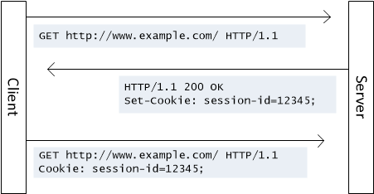
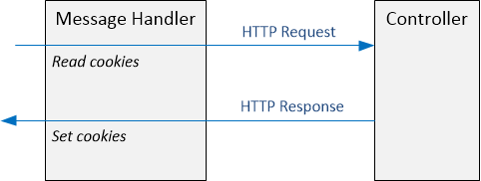
Sessions-Cookies-Cache
Http-REST i Web API je stateless po prirodi
Moguće je omogućiti sa IRequiresSessionState
Rezultat: HttpContext.Current.Session[key]
Cookies
HttpResponseMessage.Headers.AddCookies
Cache
HttpContext.Current.Cache[key]

Slide 76
Debugging
Browser developer tools (aka F12)
Network calls (Request-Response)
Sources (*.js, Angular 1, jQuery, AngularJS)
POSTMAN – Chrome extension
Fiddler
Visual Studio build-in support

